Slide 1
Hidden Hurdles
By Team 3
Manasa T Thipparthi
Saijyothi Gudibandi
Sujitha Puthana
Sri Harsha Kumar Raja Golla

Slide 2
Overview
Proposed
To develop an application that used image classification algorithm.
The image classification should be done using Clarifai API, Machine Learning, Deep Learning
Find out the best model based on the accuracy of the results produced by the above 3 models.
Developed
We designed a web based Hidden objects game using the image classification algorithm.
We implemented Clarifai API, Random forests algorithm using Spark in Machine learning, Inception-v3 using tensor flow in deep learning.
After regressive tests we observed the accuracy of all the 3 models.
We used self captured images, Caltech 256 image data sets in training our model.

Slide 3









Technologies Used

Slide 4
Details of our Application
It’s a web based game designed with 3 different levels of fun.
Users start the game and select their desired level.
User should find out all the mentioned hidden objects from the page in the stipulated time
Once user clicks an object, it will be processed using one of the 3 algorithms and the class name is returned back.
Bulb glows on the object name if the selection is a right one.
In cases of difficulty we included a hints section as well as Google Conversation API for users convenience.

Slide 5
Clarifai API
We used a REST API call and send our image as an input to the Clarifai API.
Clarifai API returns tags for our image
Search for our images tag and if found we increment the score.
Machine Learning
We used the decision tree algorithm using spark
Trained our model with a dataset of size 40 images in each class.
Our image is sent as an input to the program and the class name is sent as an output.
Deep Learning
We used Retrain inception model in tensor flow.
We have retrained our datasets with an inception model that is already trained with 1000 classes
Our image is sent as an input to the program and the class name is sent as an output

Slide 6
Clarifai API
We obtained an accuracy of 89% using the Clarifai API
Machine Learning
We obtained an accuracy of around 95% for the trained model.
Deep Learning
We Obtained an accuracy of 98% for the Retrained Inception model using our dataset.

Slide 7

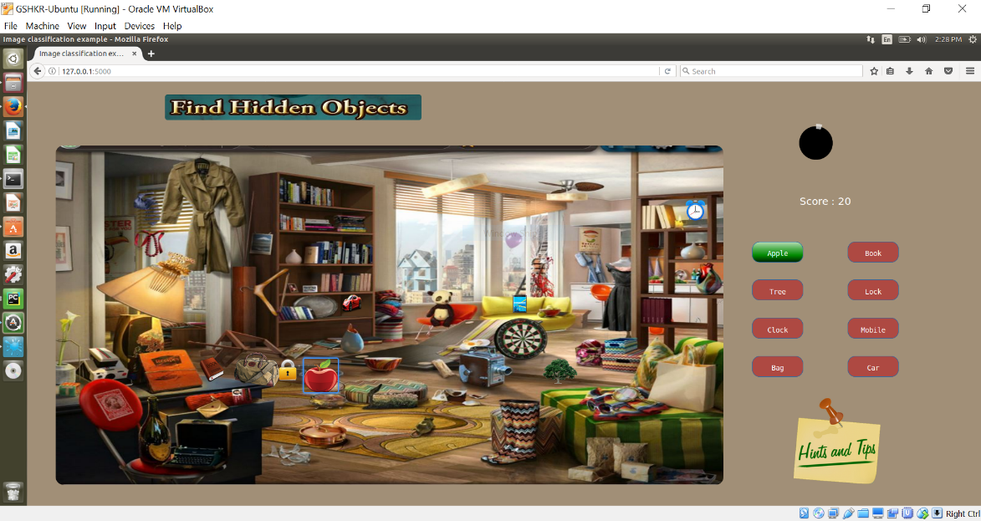
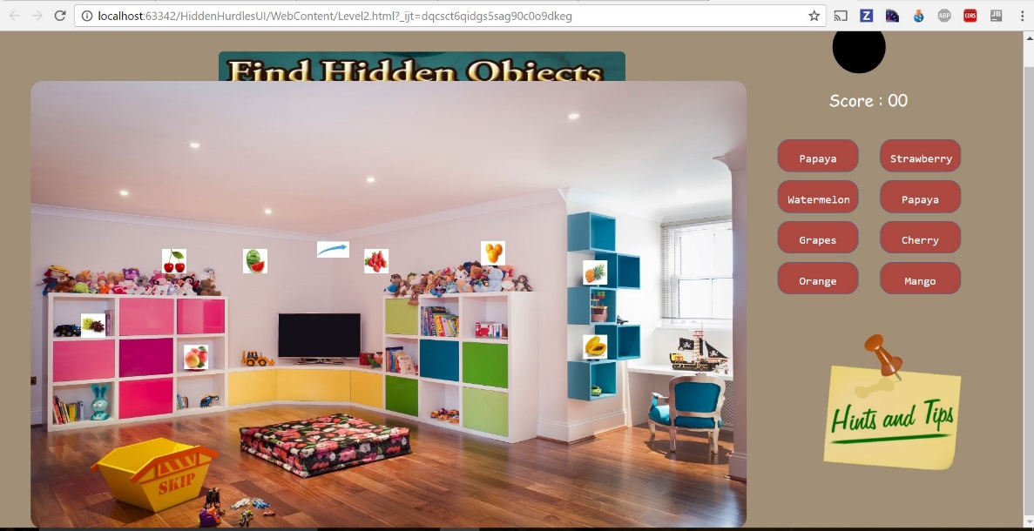
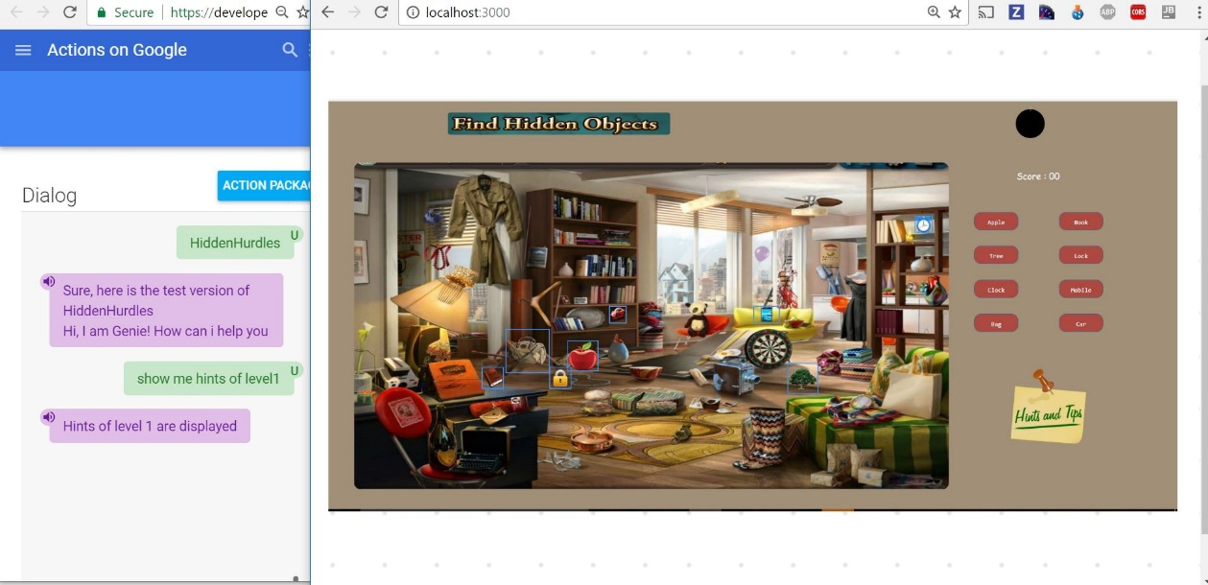
Screenshots

Slide 8
Conclusions
We observed that the Clarifai API gives us some irrelevant tags in some cases. For example when we give an image of a pen it produced the highest percentage tag as Pencil and pen was not in the tags list.
As we considered a small data set we observed that in some cases one class is predicted as another class using the Machine Learning algorithm.
The training accuracy obtained in the Retrained Inception model outperformed all the previous algorithms.
Observing the performances in terms of accuracy for all the 3 proposed models we found that the deep learning model i.e. inception-v3 using tensor flow gave us the best accuracy i.e. 98% with our data set.

Slide 9
Thank You ☺

